Slide 1
Math 4400: Applied Multivariate Statistics
Time & Place: 1:00 p.m – 1:50 p.m. MWF in LA 006
Instructor: Xiaoyi Ji (Sherry) Mailbox: Faculty workroom
Email: Xiaoyi.Ji@uvu.edu Office: LA 121V
Phone: 801-863-6057 Office Hours: MTTF 12:00- 1:00 pm or by appointment
Prerequisite: Math 2050, Math 2270, and Math 4710 with a C or better, or equivalent.
Text: An introduction to Applied Multivariate Analysis with R by Brian Everitt. Springer (2011)

Slide 2
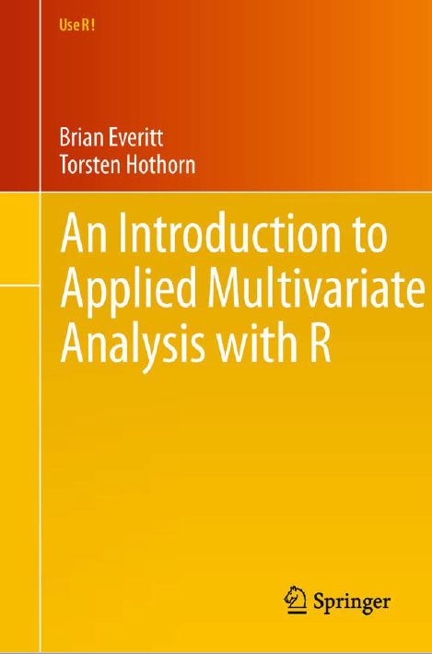

Slide 3
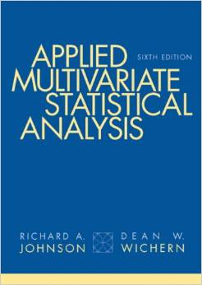

Slide 4
Matrices and Vectors
Measures of Central Tendency, Dispersion and Association
Linear Combinations of Random Variables
Graphical Display of Multivariate Data
Multivariate Normal Distribution
Sample Mean Vector and Sample Correlation and Related Inference Problems
Multivariate Conditional Distribution and Partial Correlation
Inferences Regarding Multivariate Population Mean
Multivariate Analysis of Variance (MANOVA)
Repeated Measures Analysis
Discriminant Analysis
Principal Components Analysis (PCA)
Factor Analysis
Canonical Correlation Analysis
Cluster Analysis
Multivariate Data and Multivariate Analysis
Looking at Multivariate Data: Visualization
Principal Components Analysis
Multidimensional Scaling
Exploratory Factor Analysis
Cluster Analysis
Confirmatory Factor Analysis and Structural Equation Models
The Analysis of Repeated Measures Data

Slide 5
Course Topics
Identify and organize multivariate data
Summary statistics for multivariate data
multivariate data visualization
principal components analysis
Canonical correlation analysis
Exploratory factor analysis
Multidimensional scaling and correspondence analysis
Cluster analysis
Apply Multivariate Analysis of Variance

Slide 6
Learning Objectives
Identify and understand the structure of multivariate data and be able to phrase the appropriate scientific questions in terms of parameters of interest.
Understand the basic logic behind each method's construction.
Understand the various assumptions needed for the various methodologies covered in the class and determine which multivariate methods are appropriate for a given situation.
Implement analyses of these methods in a statistical software package and interpret the output for each of the methods.

Slide 7
Homework, Tests, and Final Exam Policies
Homework will be assigned often in class and due dates will be the following Monday or Wednesday when Monday (Jan 16 and Feb 20) is holiday. Your homework, tests, and final exam must be done neatly and provide sufficient explanation. What's sufficient explanation? A good guide is to think about whether another student in the class who didn't know how to do this particular problem could understand your solution. Late homework assignments will not be accepted, unless the student obtains the permission of the instructor prior to homework being due.
Homework assignment of each chapter will be posted under the folder of Files on Canvas
There will be three mid-terms exams with 300 points each.
Exam 1 – Feb. 2nd Exam 2 – Mar. 13th Exam 3 – Apr. 17th
Final exam
Total 150 credits for final exam. Failure to take the final exam will result in a grade of UW or E for the course regardless of other grades.

Slide 8
Grading
Your final grade for this course will be determined as followed: Homework 25%, three Tests 50%, and Final exam 25%.
Computing
Use of a computer is required for the analysis of multivariate data. The examples in class will be done using R or SAS. Everyone is encouraged to download a free copy of R. All necessary analyses will be able to be done in R or SAS.
Group work
Two students work as a group in the class. Switch the people in the groups after the exams.

Slide 9
Questions?

Slide 10
1.1 Why multivariate analysis?
Psychologists and other behavioral scientists often record the values of several different cognitive variables on a number of subjects.
e.g. Data set: Personality and Cognition
16 variables were sampled to develop online measures of ability. These 16 items reflect four lower order factors (verbal reasoning, letter series, matrix reasoning, and spatial rotations)

Slide 11
https://vincentarelbundock.github.io/Rdatasets/datasets.html
 | reason.4 | reason.16 | reason.17 | reason.19 | letter.7 | letter.33 | letter.34 | letter.58 | matrix.45 | matrix.46 | matrix.47 | matrix.55 | rotate.3 | rotate.4 | rotate.6 | rotate.8
5 | 0 | 0 | 0 | 0 | 0 | 1 | 0 | 0 | 0 | 0 | 0 | 1 | 0 | 0 | 0 | 0
6 | 0 | 0 | 1 | 0 | 1 | 0 | 1 | 0 | 0 | 0 | 0 | 0 | 0 | 0 | 1 | 0
7 | 0 | 1 | 1 | 0 | 1 | 0 | 0 | 0 | 1 | 1 | 0 | 0 | 0 | 0 | 0 | 0
8 | 1 | NA | 0 | 0 | 0 | 0 | 1 | 0 | 0 | NA | 0 | 0 | 0 | 0 | 0 | 0
9 | NA | 1 | 1 | 0 | 0 | 1 | 0 | NA | 1 | 1 | 0 | 0 | 0 | 0 | 0 | 0
10 | 1 | 1 | 1 | 1 | 1 | 1 | 1 | 1 | 1 | 1 | 1 | 0 | 1 | 1 | 1 | 0
11 | 1 | 1 | 1 | 1 | 1 | 1 | 1 | 1 | 1 | 1 | 1 | 0 | 1 | 1 | 1 | 1
12 | 0 | 1 | 0 | 0 | 0 | 0 | 0 | 0 | 0 | 1 | 1 | 0 | 0 | 1 | 0 | 0
13 | 1 | 1 | 0 | 1 | 0 | 1 | 1 | 1 | 1 | 0 | 0 | 0 | 0 | 0 | 0 | 0
14 | 1 | 1 | 1 | 1 | 0 | 0 | 1 | 0 | 1 | 1 | 0 | 0 | 0 | NA | 0 | 0
15 | 0 | 0 | 0 | 0 | NA | 0 | 0 | 0 | 1 | 0 | 1 | 0 | 0 | 0 | 1 | 0
16 | 1 | 1 | 1 | 0 | 1 | 1 | 1 | 1 | 1 | 1 | 1 | 0 | 0 | 0 | 0 | 0
17 | 0 | 0 | 0 | 0 | 0 | 0 | 1 | 1 | 0 | 1 | 0 | 1 | 0 | 0 | 0 | 0
18 | 1 | 1 | 1 | 1 | 1 | 1 | 1 | 0 | 1 | 1 | 1 | 0 | 0 | 0 | 0 | 0
21 | 1 | 1 | 1 | 0 | 0 | 1 | 0 | 0 | 1 | 1 | 1 | 1 | 0 | 0 | 1 | 0
22 | 1 | 1 | 1 | 1 | 1 | 0 | 0 | 1 | 1 | 1 | 1 | 1 | 0 | 0 | 0 | 0
23 | 1 | 1 | 1 | 1 | 1 | 1 | 1 | 1 | 1 | 1 | 1 | 1 | 0 | 1 | 1 | 1
24 | 1 | 1 | 1 | 1 | 1 | 1 | 0 | 1 | 1 | 1 | 1 | 1 | 1 | 1 | 1 | 1
25 | 1 | 0 | NA | 0 | 1 | 0 | 1 | 1 | 1 | 1 | 0 | 0 | 0 | 0 | 0 | 0
26 | 1 | 1 | 1 | 1 | 1 | 1 | 0 | 1 | 1 | 1 | 1 | 0 | 0 | 1 | 1 | 1
27 | 0 | 1 | 1 | 1 | NA | 0 | 0 | 0 | 1 | 0 | 0 | 1 | 0 | 0 | 0 | 0
30 | 1 | 1 | 1 | 1 | 1 | 1 | 1 | 1 | 0 | 1 | 1 | 1 | 1 | 0 | 1 | 0
31 | 1 | 1 | 1 | 1 | 1 | 1 | 1 | 1 | 1 | 0 | 1 | 1 | 0 | 0 | 0 | 0

Slide 12
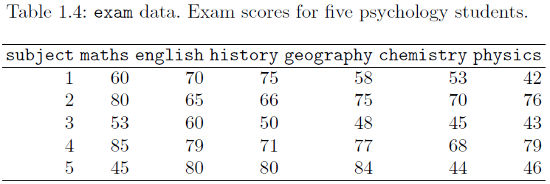
Educational researchers may be interested in the examination marks obtained by students for a variety of different subjects.

Slide 13
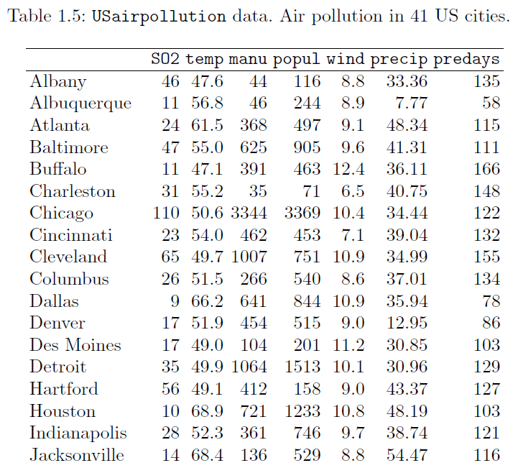
Environmentalists might assess pollution levels of a set of cities along with noting other characteristics of the cities related to climate and human ecology.

Slide 14
2. What is multivariate statistical analysis?
Multivariate statistical analysis is the simultaneous statistical analysis of a collection of variables.

Slide 15
Advantages of multivariate analysis
Close resemblance to how the researcher thinks.
Easy visualization and interpretation of data.
More information is analyzed simultaneously, giving greater power.
Relationship between variables is understood better.
Focus shifts from individual factors taken singly to relationship among variables.

Slide 16

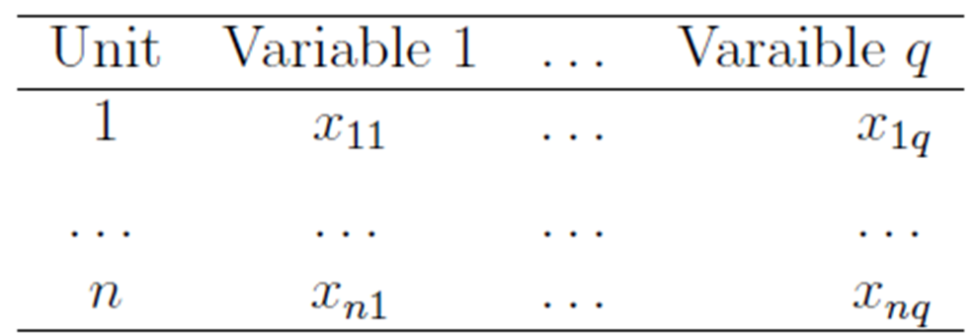

Slide 17
3. How to choose variables?
The variables are chosen by design.
In general, main requirements for the selection of variables to be used in an MVA are those of high validity and reliability of the measures used as dependent or independent variables.
Type of variables we met:

Slide 18
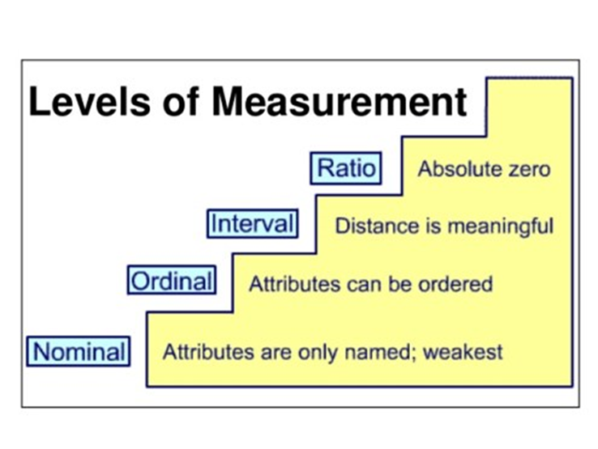
4. The four levels of measurements of variables

Slide 19

4. The level of measurements of variables
Nominal scale variables can be used to do cross tabulations. The chi-square test can be performed on a cross-tabulation of nominal scale data.
Ordinal scale variables can used to do frequency tables and cross tabulations. We can also use statistics median various percentiles such as the quartile, and the rank correlation on ordinal data.

Slide 20
Interval scale variables can be used to do difference. But it does not make sense to compare two values with ratio.
e.g. It does not say that 80 degrees is "twice as hot" as 40 degrees. Such a claim would depend on an arbitrary decision about where to "start" the temperature scale, namely, what temperature to call zero.
Ratio scale variables: All arithmetic operations are possible on a ratio scaled variable. All other statistic-like averages such as standard deviation and Pearson correlation. Additionally, the tests such as the t-test, F-test, correlation and regression are also included with ratio-level variables.
We can do any mathematical procedure with ratio scale data that is not possible with nominal, ordinal, and interval scale data.

Slide 21
The level of measurements of variables | The values can be ranked | The difference of values is consistency | The zero has meaning
Nominal | No | No | No
Ordinal | Yes | No | No
Interval | Yes | Yes | No
Ratio | Yes | Yes | Yes

Slide 22

The level of measurements of variable | The values can be ranked | The difference of values is consistency | The zero has meaning
Nominal | No | No | No
Ordinal | Yes | No | No
Interval | Yes | Yes | No
Ratio | Yes | Yes | Yes

Slide 23
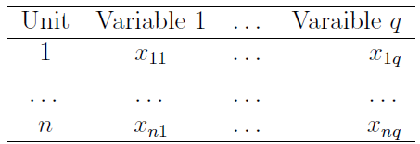
1.2 Understand Multivariate data

Slide 24
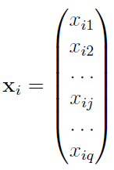
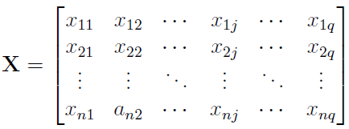
1. Data matrix and data vector
Relate Data set to math variable
Relate Data set to math variable

Slide 25
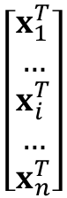
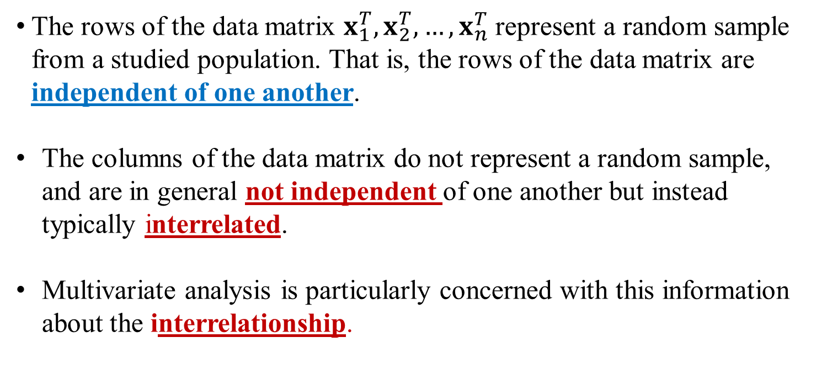
$$\left[\begin{aligned}x_{1}^{T} \\ … \\ x_{i}^{T} \\ … \\ x_{n}^{T}\end{aligned}\right]$$
The rows of the data matrix $x_{1}^{T}, x_{2}^{T},…, x_{n}^{T}$ represent a random sample from a studied population. That is, the rows of the data matrix are independent of one another.
The columns of the data matrix do not represent a random sample, and are in general not independent of one another but instead typically interrelated.
Multivariate analysis is particularly concerned with this information about the interrelationship.

Slide 26
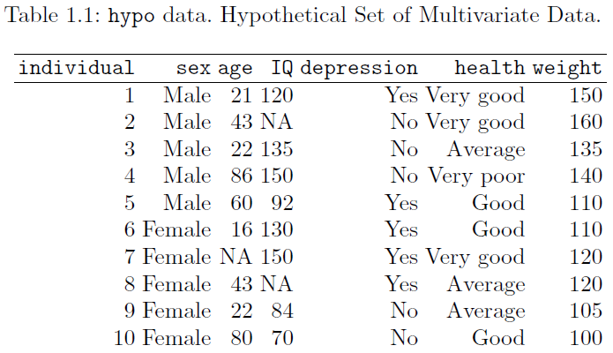
Ex 1.2.1 For given Table 1.1(page 4): hypo data.
Identify and interpret the number of units, the number of variables, the types of variables, and the levels of measurements of variables, respectively.

Slide 27
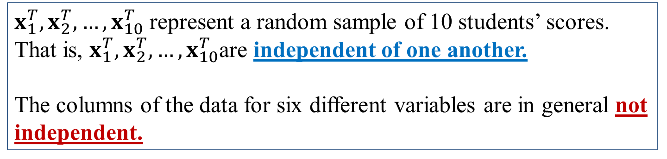
Sex, age, IQ, depression, health, and weight
 | can be ranked | The difference is consistency | The zero has meaning
Nominal: Sex, depression | No | No | No
Ordinal: health | Yes | No | No
Interval: IQ | Yes | Yes | No
Ratio: Weight, age | Yes | Yes | Yes
$x_{1}^{T}, x_{2}^{T},…, x_{10}^{T}$ represent a random sample of 10 students’ scores. That is, $x_{1}^{T}, x_{2}^{T},…, x_{10}^{T}$are independent of one another.
The columns of the data for six different variables are in general not independent.

Slide 28
Ex 1.2.1 For given Table 1.1(page 4): hypo data.
Read Table 1.1 as a data matrix by using statistical software.
Tools, Install Packages, MVA
library (“MVA”)
hypo<-read.csv(“~/hypo.csv”)
hypo

Slide 29
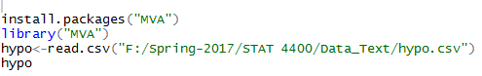
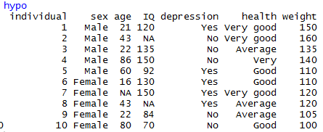
Ex 1.2.1 For given Table 1.1(page 4): hypo data.
Read Table 1.1 as a data matrix by using statistical software.
Method 1

Slide 30
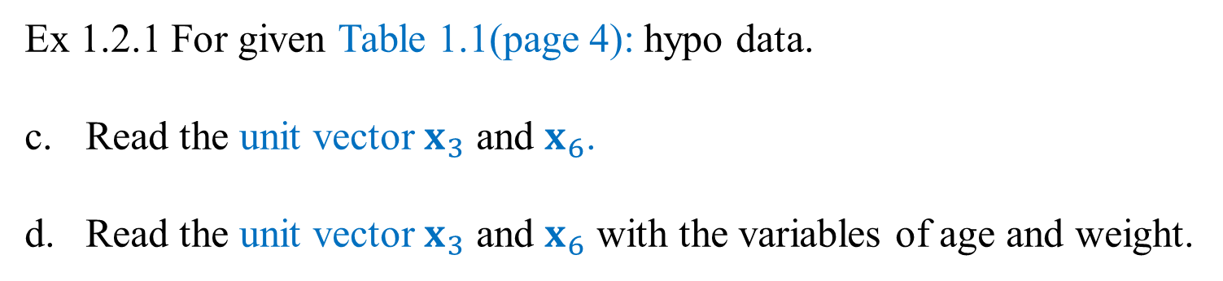
Ex 1.2.1 For given Table 1.1(page 4): hypo data.
Read the unit vector $x_{3}$ and $x_{6}$.
Read the unit vector $x_{3}$ and $x_{6}$ with the variables of age and weight.

Slide 31
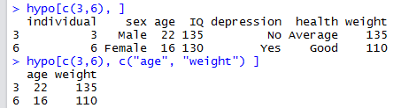
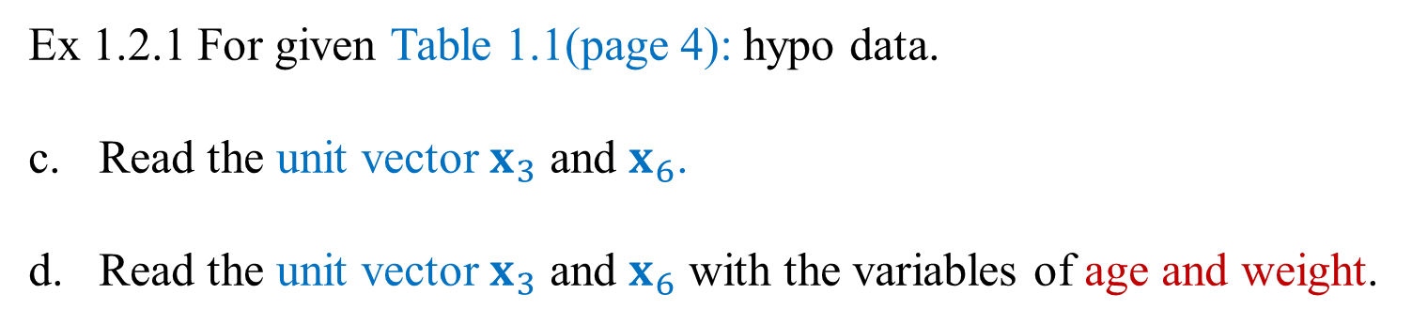
Ex 1.2.1 For given Table 1.1(page 4): hypo data.
Read the unit vector $x_{3}$ and $x_{6}$.
Read the unit vector $x_{3}$ and $x_{6}$ with the variables of age and weight.

Slide 32
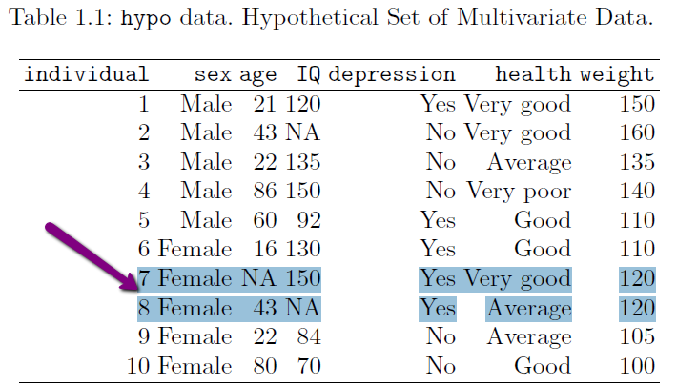
1.3 The possible problem of missing values
Complete-case analysis: Omitting any case with a missing value on any of the variables. That is, deleting any observations that have any missing values.

Slide 33
But complete-case analysis is not recommended:
With many variables being measured, this can lead to a lot of observations being deleted and highly reduced sample size and the variability increasing.
Can lead to biased estimates unless the missing data are missing completely at random.

Slide 34
Example 1.3.1 For given hypo data, compute the deference of the sample mean of weight with/without deleting the observations that have any missing values.

Slide 35
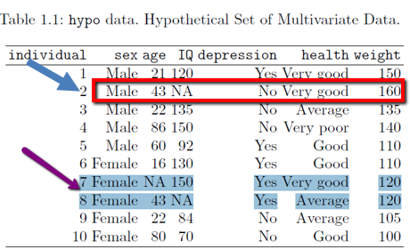
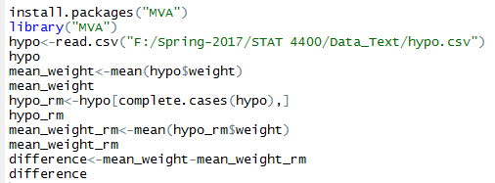
Complete-case analysis: Omitting any case with a missing value on any of the variables. That is, deleting any observations that have any missing values.

Slide 36
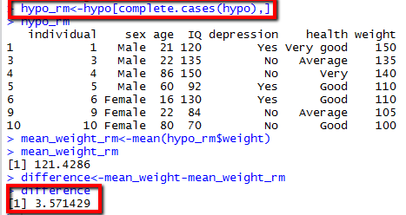
Complete-case analysis: Deleting any observations that have any missing values.

Slide 37
2. Multiple imputation: Fill in missing values in with plausible values.
Single Imputation Methods:
mean/median/mode substitution: replace missing value with sample mean, median, or mode for a given variable.
KNN Imputation: a given number of units that are most similar to the unit of interest. The similarity of two units is determined using a distance function.
Single regression: Replaces missing values with predicted score from a regression equation
Model-based Methods
Maximum likelihood: value that is most likely to have resulted in the observed data
Multiple imputation

Slide 38
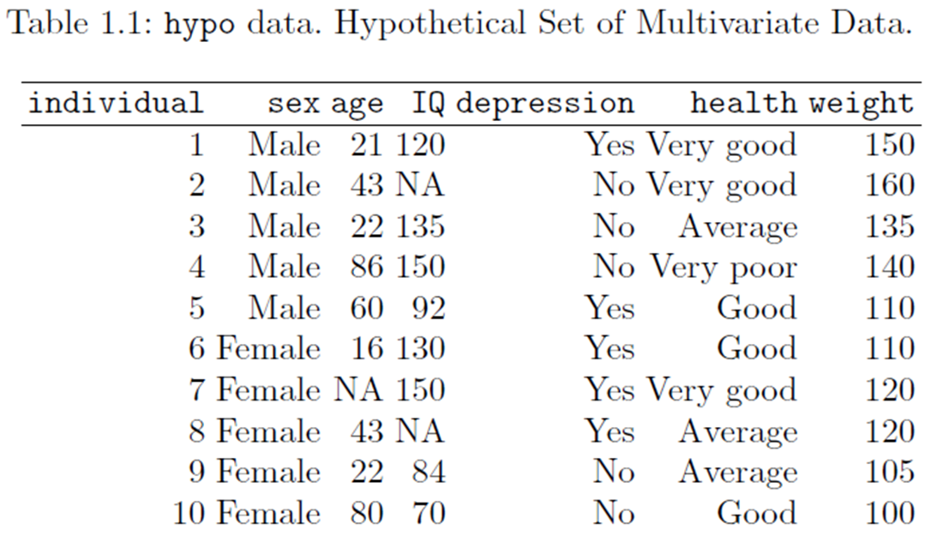
Example 1.3.2 Continue Example 1.3.1: Fill in the missing values in their sample means.
sample means: mean_age, mean_iq

Slide 39
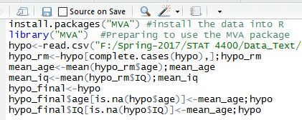
Example 1.3.2 Continue Example 1.3.1: Fill in the missing values in their sample means.
sample means: mean_age, mean_iq

Slide 40
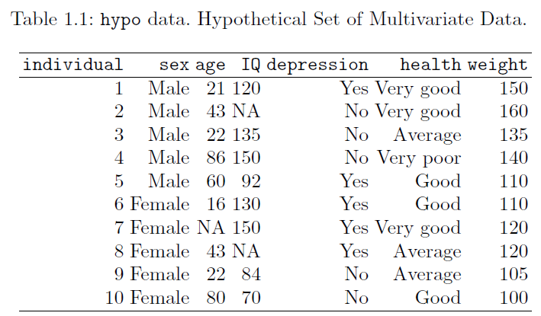
1.4 Some multivariate data sets

Slide 41
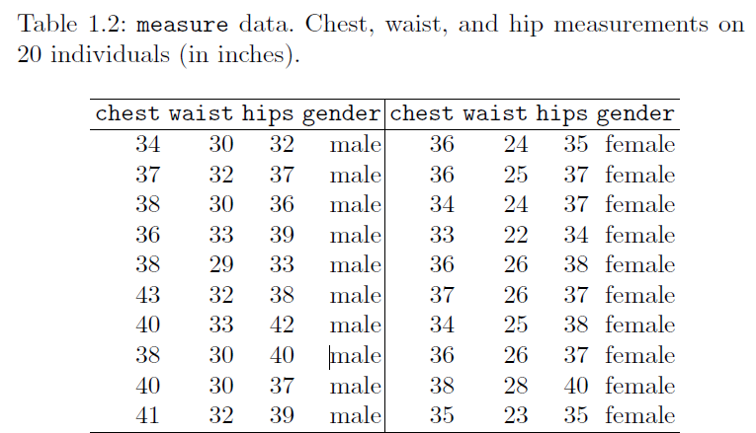
1.4 Some multivariate data sets

Slide 42
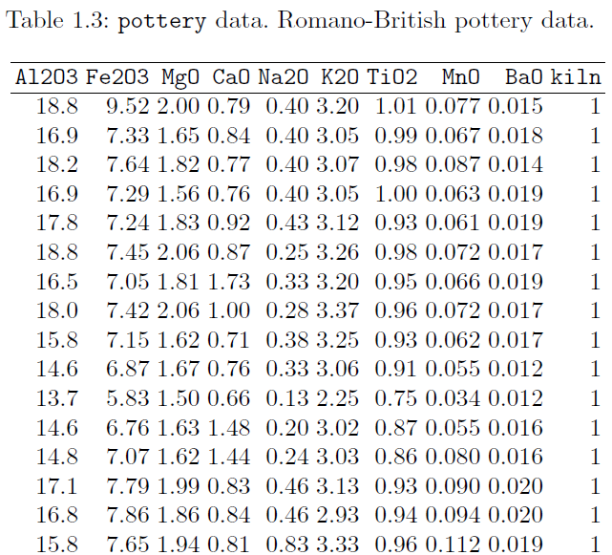
1.4 Some multivariate data sets

Slide 43
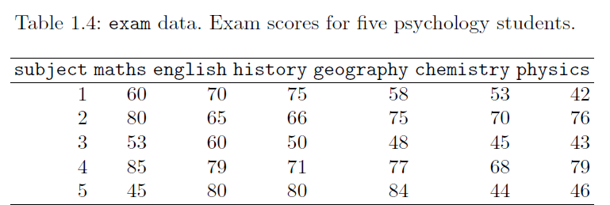
1.4 Some multivariate data sets

Slide 44
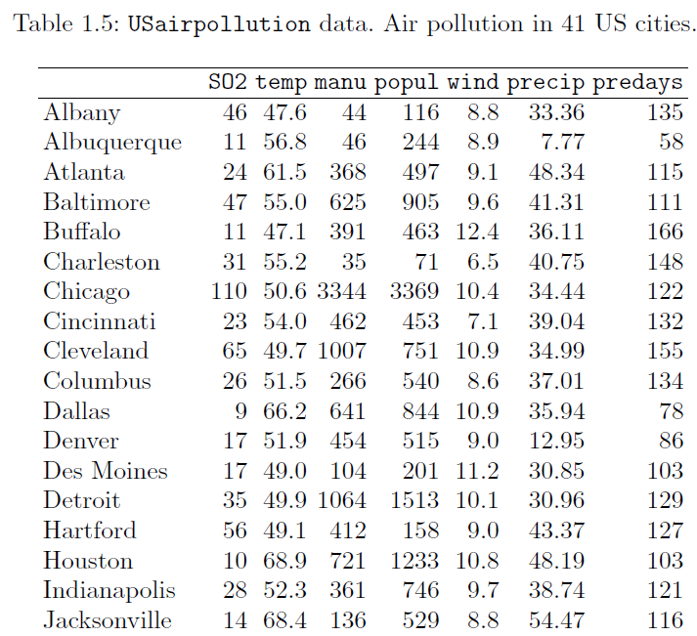
1.4 Some multivariate data sets

Slide 45
1.5 Summary Statistics for Multivariate Data
Data plots can use to evaluate patterns and behavior in data. (Ch 2)
Central tendency describes a typical value for each variable.
Dispersion: how far apart are the individual observations from a central value for a given variable.
Correlation: how does each variable relate to the remaining variables, how are the variables simultaneously related to one another when more than one variable are studies together. (Ch 2-8)
Distance: For some multivariate techniques such as multidimensional scaling and cluster analysis, the concept of distance between the units in the data is often of considerable interest and importance. (Ch 4, 7)

Slide 46
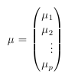
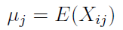
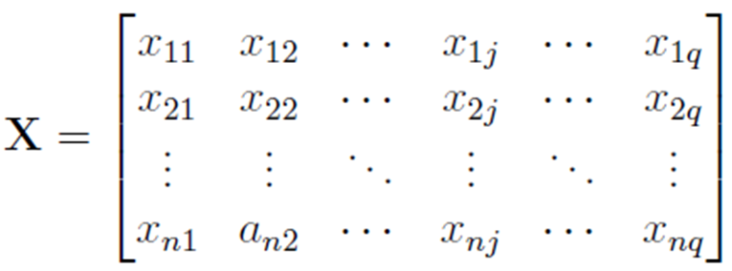
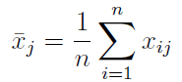
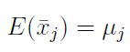
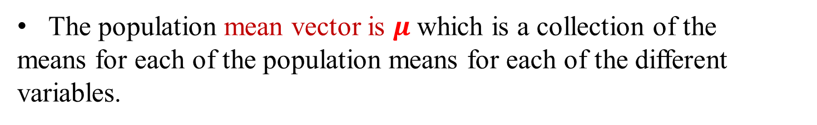
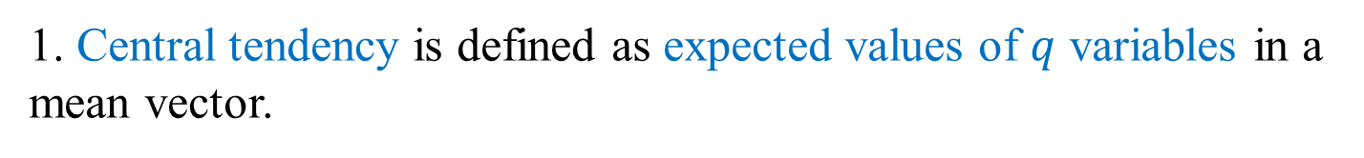
1. Central tendency is defined as expected values of $q$ variables in a mean vector.
The population mean vector is $μ$which is a collection of the
means for each of the population means for each of the different variables.

Slide 47
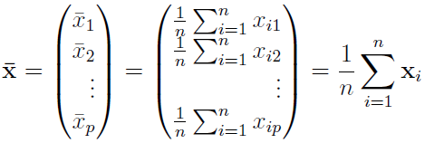
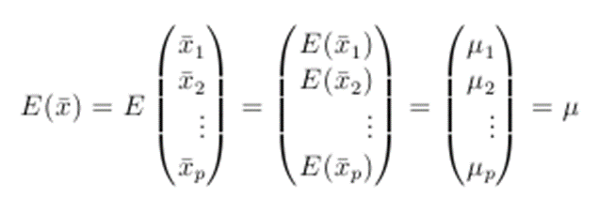
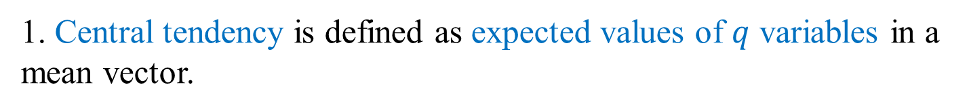
1. Central tendency is defined as expected values of $q$ variables in a mean vector.
We can estimate this population mean vector by a sample vector because

Slide 48
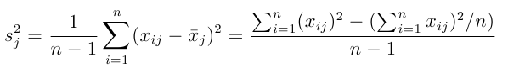
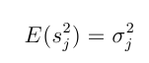
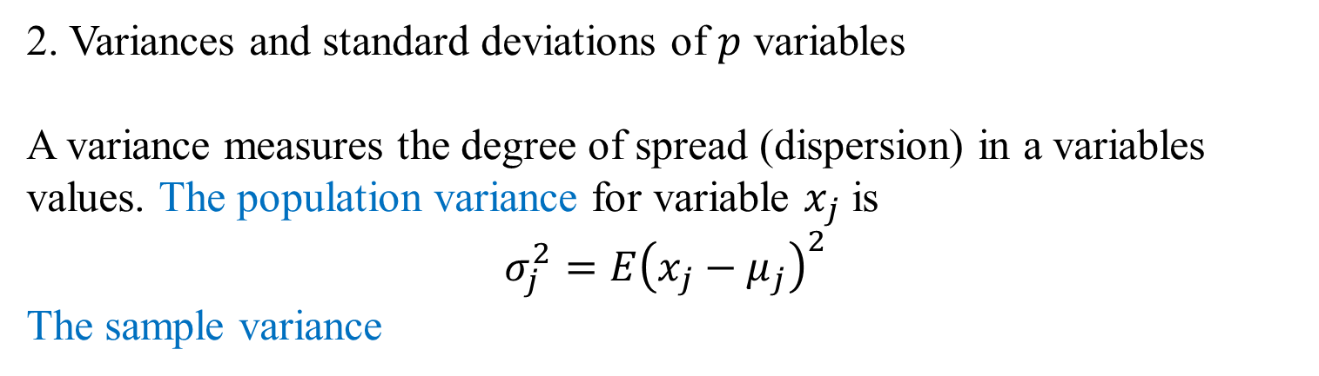
2. Variances and standard deviations of $p$ variables
A variance measures the degree of spread (dispersion) in a variables values. The population variance for variable $x_{j}$ is
$$σ_{j}^{2}=E{\left(x_{j}−μ_{j}\right)}^{2}$$
The sample variance
The population mean of the sample variance is equal to the population variance:

Slide 49
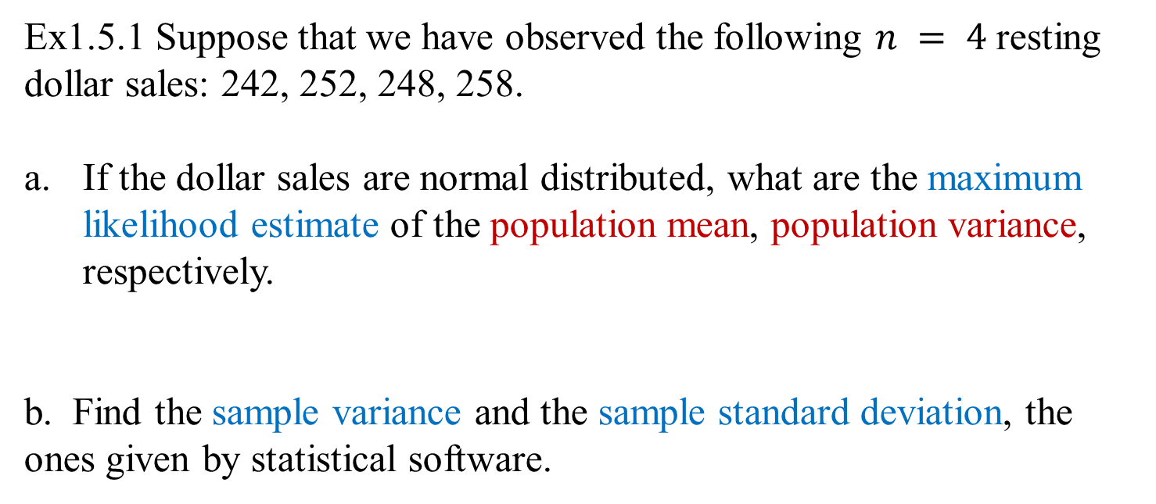
Ex1.5.1 Suppose that we have observed the following $n = 4$resting dollar sales: 242, 252, 248, 258.
If the dollar sales are normal distributed, what are the maximum likelihood estimate of the population mean, population variance, respectively.
b. Find the sample variance and the sample standard deviation, the ones given by statistical software.

Slide 50
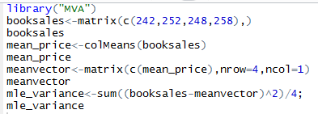
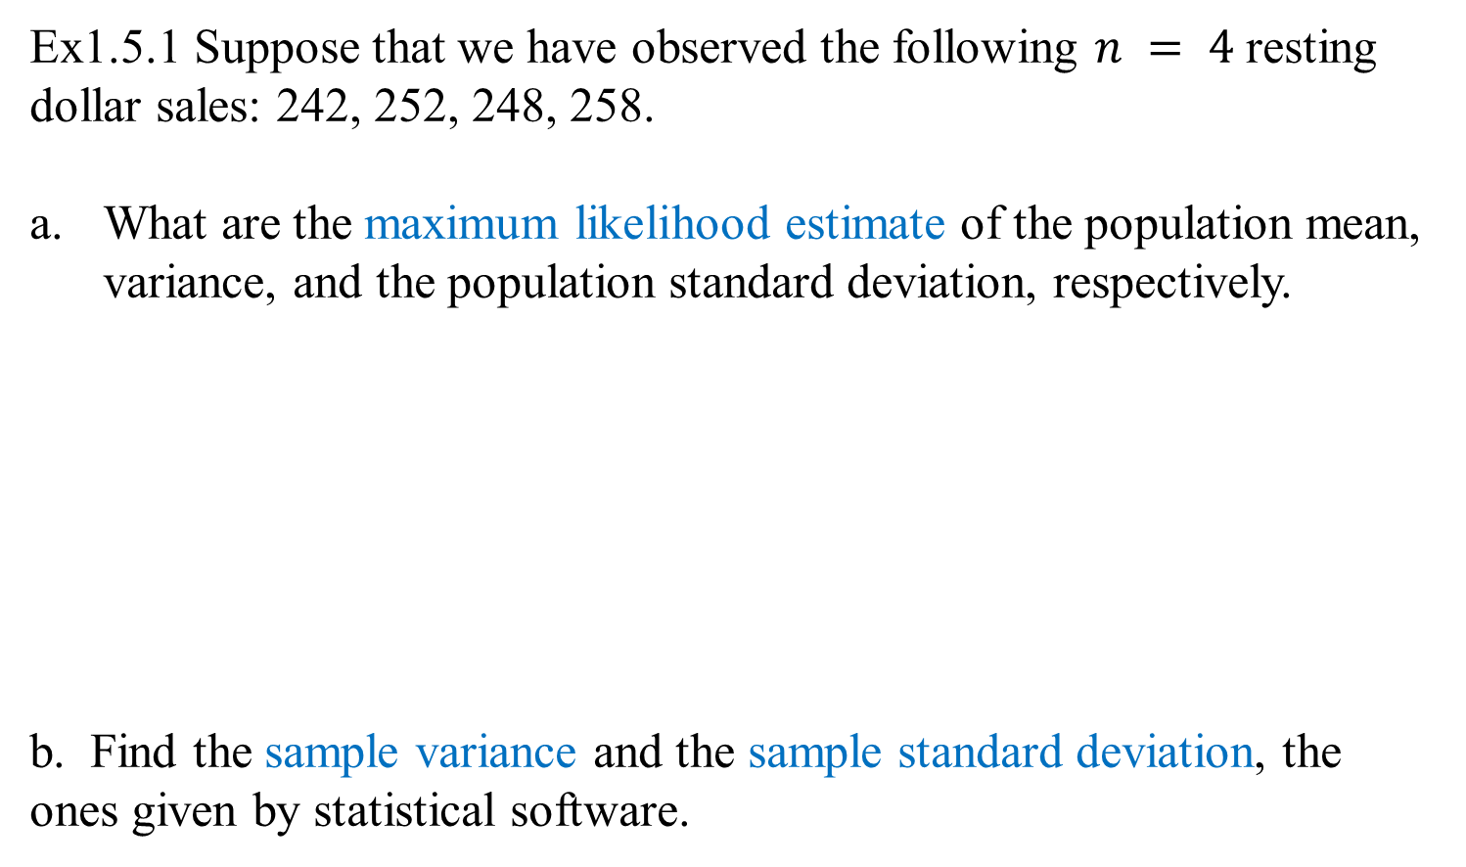
Ex1.5.1 Suppose that we have observed the following $n = 4$resting dollar sales: 242, 252, 248, 258.
What are the maximum likelihood estimate of the population mean, variance, and the population standard deviation, respectively.
b. Find the sample variance and the sample standard deviation, the ones given by statistical software.

Slide 51
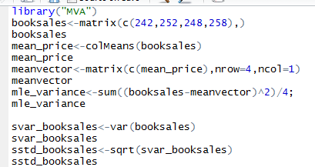
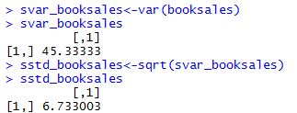
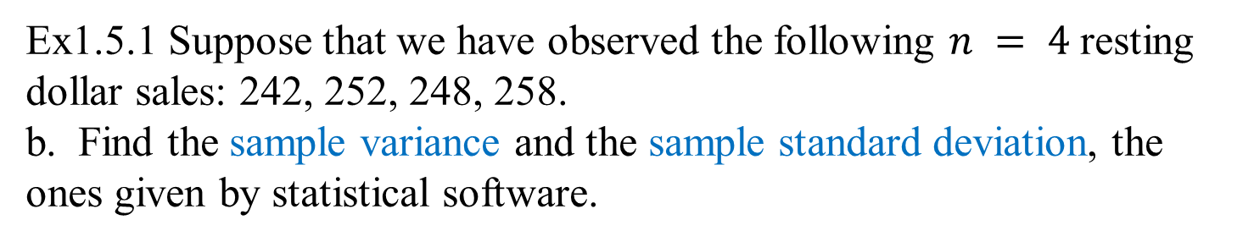
Ex1.5.1 Suppose that we have observed the following $n = 4$resting dollar sales: 242, 252, 248, 258.
b. Find the sample variance and the sample standard deviation, the ones given by statistical software.

Slide 52
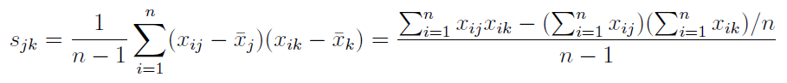
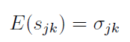
3. Covariance and Correlation

Slide 53


3. Covariance and Correlation

Slide 54


Ex 1.5.2 Suppose that we have observed the following $n = 4$observations for variables $X_{1}$ and $X_{2}$.
a. Find sample variance-covariance matrix by hands.

Slide 55


Ex 1.5.2 b. Find the mean vector, sample variance-covariance matrix using statistical software.
c. What cause the negative covariance between the number of books and the dollar sales?

Slide 56
SAS code Method 1 use iml
data one;
input x1 x2;
datalines;
4 242
5 252
4 248
3 258
;
run;
proc iml;
use one;
read all var{x1 x2} into x;
n=nrow(x);
s_mean=x[+,]/n;
print s_mean;
quit;

Slide 57
SAS code Method 1 use iml
data one;
input x1 x2;
datalines;
4 242
5 252
4 248
3 258
;
run;
proc iml;
use one;
read all var{x1 x2} into x;
n=nrow(x);
s_mean=x[+,]/n;
Ones=j(n,1,1);
s_var=(x-ones*s_mean)[##,]/n;
print s_mean s_var;
quit;

Slide 58
SAS code
data one;
input x1 x2;
datalines;
4 242
5 252
4 248
3 258
;
run;
proc iml;
use one;
read all var{x1 x2} into x;
S_mean=mean(x);
S_var=var(x);
print s_mean s_var;
quit;

Slide 59
Problems
The magnitude of the covariance value is not particularly helpful as it is a function of the magnitudes (scales) of the two variables. This quantity is a function of the variability of the two variables, and so, it is hard to tease out the effects of the association between the two variables from the effects of their dispersions.
Example: Collect the data of your heights in inches and in meters, respectively.
Compare the variance of the two data sets, are they the same?
Compute the covariance of the two data sets. Does the result make a sense to you?

Slide 60
Correlation matrix
To assess the strength of an association, we use correlation values.
Example: Collect the data of your heights in inches and in meters, respectively.
c. Compute the correlation matrix of the two data sets using statistical software. Does the result make a sense to you?

Slide 61




The population covariance divided by the product of the population standard deviations:
$ρ_{ij}$may be estimated by the sample covariance and standard deviations:
The population & the sample correlation must lie between $−1$and 1
0 indicates that the two variables are uncorrelated.
$r_{ij}$ close to ±1 indicate a strong positive or negative dependence.
Correlation coefficient has no unit. It means that changing of the units of the variables does not change the value of the value of the correlation coefficient.

Slide 62


2) Sample covariance between variables $j$ and $k$ is
$S$ is unbiased for the population variance covariance matrix

Slide 63


Slide 64


Ex 1.5.3 Continue Ex 1.5.2 to find the complete sample correlation matrix based on the covariance matrix.
Method 1:
Define $D^{−1/2}$
Matrix multiplication in R: %*%

Slide 65





Ex 1.5.3 Continue Ex 1.5.2 to find the complete sample correlation matrix based on the covariance matrix.
Define $D^{−1/2}$
Dminus12<-diag(1/sqrt(diag(v)))
Matrix multiplication in R: %*%
R<-Dminus12%*%v%*%Dminus12

Slide 66

Ex 1.5.3 Continue Ex 1.5.2 to find the complete sample correlation matrix.
Method 2:

Slide 67
Additional Measures of Dispersion
The overall measure of dispersion in the data include all of the variables simultaneously, rather than one at a time.
The total variation of a random vector X is simply the trace of the population variance covariance matrix.
It can be estimated by:
The total variation is of interest for principal components analysis (chapter 3) and factor analysis (chapter 5).
The problem with total variation is that it does not take into account correlations among the variables.

Slide 68






Generalized Variance $|Σ|$
The generalized variance (GV) of a $q$-dimensional random vector variable X is defined as the determinant of its variance-covariance matrix.
GV scalar measure of overall multidimensional scatter.
However, Two very different matrices may yield the same value of the generalized variance.
$r_{1}=(a, b, c), r_{2}$=($d, e, f$), and $r_{3}$=($g, h, i$)

Slide 69


The result learned from linear algebra or Calculus II
The volume of this parallelepiped is the absolute value of the determinant of the matrix formed by the rows constructed from the vectors
$r_{1}=(a, b, c), r_{2}$=($d, e, f$), and $r_{3}$=($g, h, i$)
$\left|\begin{matrix}a & b & c \\ d & e & f \\ g & h & i\end{matrix}\right|$

Slide 70

The relationship between the correlation and the area of the scatter plot
$$the area \left(volumn\right) is _____________ as the correlation is __________$$

Slide 71


Generalized Variance $|Σ|$
This measure takes a large value when the various variables show very little correlation among themselves.
This measure takes a small value if the variables show very strong correlation among themselves, either positive or negative.

Slide 72



Ex 1.5.4 (continue the previous Ex 1.5.2 2) Compute the total variance and generalized variance.

Slide 73



5. Distance
1) Euclidean distance:
a. The distance between the units $x_{i}$ and $x_{j}$ and distance matrix

Slide 74

5. Distance
1) Euclidean distance:
a. The distance between the units $x_{i}$ and $x_{j}$ and distance matrix
$n−1$ rows and $n−1$ columns

Slide 75
Ex1.5.5 (Table 1.2, page 8) Calculating a Euclidean distance of “Measure data" with variables chest, waist, and hip.
Read the measure data into R
Apply function in R: dist

Slide 76


Ex1.5.5 (Table 1.2, page 8) Calculating a Euclidean distance
for data “Measure data" with variable chest, waist, and hip.

Slide 77




1) Euclidean distance:
a. The distance between the units $x_{i}$ and $x_{j}$ ,
Each coordinate contributes equally the calculation of Euclidean distance.
Ex: Consider pottery data (Table 1.3, page 8), using just three continuous variable Fe2O3, MgO and CaO. What is the Euclidean distance between the first two samples, $x_{1}$ and $x_{2}$?

Slide 78



Ex: Using just three continuous variable Fe2O3, MgO and CaO. Find the distance between the first two samples, $x_{1}$ and $x_{2}$?
$$d_{12}=2.2$$

Slide 79

The contribution of Fe2O3 to this calculation is huge one.
$d_{12}=2.218≈$|9.52 -7.33| = 2.19, with only tiny (0.01) additional contributions from MgO and CaO.
If the three variables are on completely different scales of measurement and the larger Fe2O3 values have larger inter sample differences, they will dominate in the calculation of Euclidean distances.
This is the problem of standardization discussed before (covariance and correlation).
Standardization is necessary to balance out the contributions.

Slide 80

5 Distance
1) Euclidean distance:
a. The distance between the units xi and xj ,
Accounts for differences in variation.
assume that the variables are independent
Accounts for correlation

Slide 81


Example1.5.6 (Table 1.2, page 8)
Calculating a statistical distance for data “Measure data" with variable chest, waist, and hip.
b. Calculating a statistical distance for $x_{1}$ and $x_{2}$ in the data “pottery" with variable variables Fe2O3, MgO and CaO.

Slide 82


2. City-block/Manhattan distance

Slide 83


3. Mahalanobis distance or Chi-square distance
$${d_{i}^{2}=\left(x_{i}−μ\right)}^{T}Σ^{−1}(x_{i}−μ)$$
${d_{i}^{2}=\left(x_{i}−\overline{x}\right)}^{T}S^{−1}(x_{i}−\overline{x})$

Slide 84

1.6 The multivariate Normal density function
Why is the multivariate normal distribution so important?

Slide 85



Nice properties with mathematical simplicity of probability function; easy to work with; easy to obtain methods based on the distribution
Normal distribution
Student’s t distribution
F-distribution

Slide 86

Multivariate version of the Central Limit Theorem.
A collection of random vectors X₁, X₂,...,X_{n} that are iid., then the sample mean vector, $\overline{X},$is going to be approximately multivariate normally distributed for large samples.
$\sqrt{n }({\overline{X}}_{n}−μ)→N_{q}(0, ∑$ )
Many natural phenomena may also be modeled using this distribution.

Slide 87


Normal distribution of univariate:
A random variable $X$ is normally distributed with mean µ and variance $σ^{2}:$
$φ(x)$ takes a maximum when $x =μ$.
$−{\left(x−μ\right)}^{2}$ is symmetric with $μ$, then$φ(x)$ is symmetric with $x =μ.$ So the mean of $X$ is $μ$.
The variance $σ^{2}$ defines the spread of the distribution.
Generalization to p > 1 variables:

Slide 88


2. Multivariate Normal Distributions:
$\text{X} is a p×1$ random vector that is distributed according to a MND with population mean vector $μ$and population variance-covariance matrix ∑
1)
|Σ| = determinant of the variance-covariance matrix Σ
${ Σ}^{−1}$ inverse of the variance-covariance matrix Σ
Distribution will take maximum values X=$μ$
2) Mahalanobis distance:

Slide 89



2. Multivariate Normal Distributions:
Mahalanobis distance:
If the variables are uncorrelated

Slide 90

3. The linear combinations of the elements of a multivariate normal random variable
$$X\sim N\left(μ, Σ\right)$$
What is the distribution of$Y=\sum_{j=1}^{q}{c_{j}X_{j}=c^{T}X}$ ?

Slide 91


4. Other Useful Results for the MND:
If X$\sim N(μ, ∑){ and x}_{j}\sim N(μ_{j}, σ_{j}^{2})$ for all $j=1, 2, …q$. We can look at univariate tests of normality for each variable when assessing multivariate normality. The inverse is not true.
2) Any subset of the variables also has a multivariate normal distribution.
3) Any linear combination of the variables has a univariate normal distribution.
Y$\sim N(c^{T}μ, c^{T}∑c)$
4) Any conditional distribution for a subset of the variables conditional on known values for another subset of variables is a multivariate distribution.

Slide 92

Ex 1.6.1 Linear Combination of the Cholesterol Measurements were taken on $n$ heart-attack patients on their cholesterol levels. For each patient, measurements were taken 0, 2, and 4 days following the attack. Treatment was given to reduce cholesterol level. The sample mean vector is:
Variable Mean
$X_{1}$ = 0-Day 259.5
$X_{2}$ = 2-Day 230.8 S=$\left(\begin{aligned}\text{2276 1508 813 } \\ \text{1508 2206 1349 } \\ \text{813 1349 1865 }\end{aligned}\right)$
$X_{3}$ = 4-Day 221.5
The covariance matrix

Slide 93


Find the sample estimate of mean and variance of $X_{1}−X_{2}$.
Variable Mean
$X_{1}$ = 0-Day 259.5
$X_{2}$ = 2-Day 230.8
$X_{3}$ = 4-Day 221.5
The covariance matrix
$$\left(\begin{aligned}\text{2276 1508 813 } \\ \text{1508 2206 1349 } \\ \text{813 1349 1865 }\end{aligned}\right)$$

Slide 94

Find the sample estimate of mean and variance of $X_{1}−X_{2}$.
b. If we assume the three measurements have a multivariate normal distribution, find the distribution of the difference $X_{1} − X_{2}$.

Slide 95

5. Bivariate Normal Distribution
a. Set up the mean vector and variance-covariance matrix for the bivariate variables
b. Find the determinant and the inverse of the variance-covariance matrix
c. The joint probability density function of the bivariate normal variable

Slide 96



5. Bivariate Normal Distribution
a. Set up the mean vector and variance-covariance matrix for the bivariate variables
b. Find the determinant and the inverse of the variance-covariance matrix
c. The joint probability density function of the bivariate normal variable

Slide 97
d. The plot of the bivariate normal distribution
The correlation ρ is equal to zero. This special case is called the circular normal distribution.
2) As ρ increases that bell-shaped curve becomes flattened on the 45 degree line.
3) Increasing ρ to 0.9 the curve becomes broader and the 45 degree line and even flatter still in the perpendicular direction.

Slide 98

$$μ_{j}=0, { σ}_{j} = 1, r = 0.0$$
options ls=78;
title "Bivariate Normal Density";/*mean=0, variance=1*/
%let r=0.9;
data a;
pi=3.1416;
do x1=-4 to 4 by 0.1;/*why -4 to 4?*/
do x2=-4 to 4 by 0.1;
phi=exp(-(x1*x1-2*&r*x1*x2+x2*x2)/2/(1-&r*&r))/2/pi/sqrt(1-&r*&r);
output;
end;
end;
run;
proc g3d;
plot x1*x2=phi / rotate=-20;
run;

Slide 99



$$μ_{j}=0, { σ}_{j} = 1, r = 0.0$$
∑ = diag($σ_{1}^{2}, σ_{2}^{2}$), a diagonal matrix.
When take a slice parallel to x-y, you get a circle.
circular normal distribution

Slide 100



$$μ_{j}=0, { σ}_{j} = 1, r = 0.7$$
∑ is not a diagonal matrix.
When take a slice parallel to x-y, you get an ellipse that’s tilted.
Tilt depends on relative values of $σ_{1}^{2}$ and $σ_{2}^{2}$ (and scale used in plotting)

Slide 101


Overhead
$$μ_{j}=0, { σ}_{j} = 1, r = 0.7$$
proc gcontour data=a;
plot x1*x2=phi;
run;
quit;

Slide 102



Overhead
$$μ_{j}=0, { σ}_{j} = 1, r = 0.0$$
circular normal distribution
∑ = diag($σ_{1}^{2}, σ_{2}^{2}$), a diagonal matrix.
Density is “random” in the x-y plane.
When take a slice parallel to x-y, you get a circle.

Slide 103



Overhead
$$μ_{j}=0, { σ}_{j} = 1, r = 0.7$$
Density is not random in the $x−y$ plane.
There is a linear tilt (ie., density is concentrated on a line).
When take a slice parallel to x-y, you get an ellipse that’s tilted.

Slide 104

6. Exponent of Multivariate Normal Distribution
the Exponent Component${\left(x−μ\right)}^{T}Σ^{−1}(x−μ)$
As the value of${ \left(x−μ\right)}^{T}Σ^{−1}(x−μ)$increases, the value of the density function decreases. The value of${ \left(x−μ\right)}^{T}Σ^{−1}(x−μ)$increases as the distance between x and μ increases.
$d_{i}$=${\left(x−μ\right)}^{T}Σ^{−1}(x−μ)$ has a chi-square distribution with $q$ degrees of freedom.
$d_{i}$ for a specific observation $x_{i}$ is called a squared Mahalanobis distance. It is calculated as $d_{i}^{2}={\left(x_{i}−\overline{x_{i}}\right)}^{T}S^{−1}(x_{i}−\overline{x_{i}}).$

Slide 105

7 - Multivariate Normality and Outliers
Recall Q-Q Plot for Evaluating Univariate Normality and Outliers
Step 1: Rank data from the smallest to the largest, $x_{(1)}, x_{(2),}…, x_{\left(n\right)}.$
Step 2: Find the corresponding percentiles of the ordered obs. by $\frac{i−0.5}{n}$
Step 3: Find the standard normal quantiles corresponding the percentile of by $φ^{−1}(\frac{i−0.5}{n}$).
Step 4: Plot ($x_{\left(i\right)}$, $φ^{−1}(\frac{i−0.5}{n}$))
If the plot is approximately linear associated, then we say that X is draw from normal distribution.

Slide 106

7 - Multivariate Normality and Outliers
Multivariate Normality
Step 1: Compute Mahalanobis distance $d_{i}^{2}={\left(x_{i}−{\overline{x}}_{i}\right)}^{T}S^{−1}(x_{i}−\overline{x_{i}}).$
Step 2: Rank $d_{i}^{2}$ from the smallest to the largest, $d_{(1)}^{2}, d_{(2),}^{2}…, d_{\left(n\right)}^{2}.$
Step 2: Find the corresponding percentiles of the ordered obs. by $\frac{i−0.5}{n}$
Step 3: Find the standard normal quantiles corresponding the percentile of by ${chisqure}^{−1}(\frac{i−0.5}{n}$) with $q$ degrees of freedom.
Step 4: Plot ($d_{\left(i\right)}^{2}$, ${chisqure}_{q}^{−1}(\frac{i−0.5}{n}$))
If the plot is approximately linear associated, then we say that X is draw from multinormal distribution.

Slide 107


Example Examine multivariate normality of measure data in three numerical variables (Table 1.2 Page 8)

Slide 108


Example 1.6.2 Examine multivariate normality of USairpollution data (Check univariate normal for each variable)

Slide 109


Example 1.6.2 Examine multivariate normality of USairpollution data
(Check multivariate normal and outliers)

